Slide 1

Candidature Data-scientist
Fabien Roussel – Décembre 2019
OCTO Technology

Slide 2
Table of content
I. Get and choose the data
II. Prepare and describe the data
III. Machine Learning and Prediction

Slide 3
Get and choose the data
INSEE vs ENEDIS
Most promising data
Remove empty data

Slide 4
Prepare and describe the data
Outliers
Uncomplte data
PCA
Study correlation

Slide 5
Prepare and describe the data
PCA

Slide 6
Prepare and describe the data
1. Is electricity consumption explainable from external data?
2. What are the features, or group of features correlated with electricity consumption?
3. There might be a lot of dimensions in your data, how can you reduce dimensionality while keeping a maximum of information?
4. Are there major differences in consumption by department or region? If so, what are these differences? Propose some reason behind these differences
5. Which departments have a large variation in electricity consumption? A small variation?

Slide 7
Machine Learning and Prediction
RandomForestRegressor
Parameters :
n_estimators :
max_features :
min_samples_leaf :
min_samples_split :
Pourquoi choisi, pourquoi adapté,
Pt negatif positif, pk overfit (next slide) améliorations ?
NuSVR
Parameters :
C : penalty parameter
nu : ratio of wrong samples
gamma : inverse coefficient of var
Notes:
Nu +++ => underfit
Gamma +++ ➔ overfit ➔ 1/(n_features*var)

Slide 8
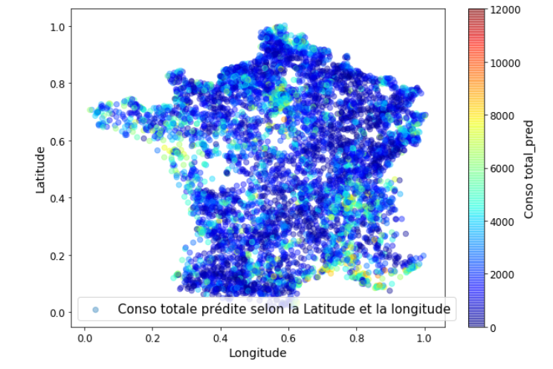
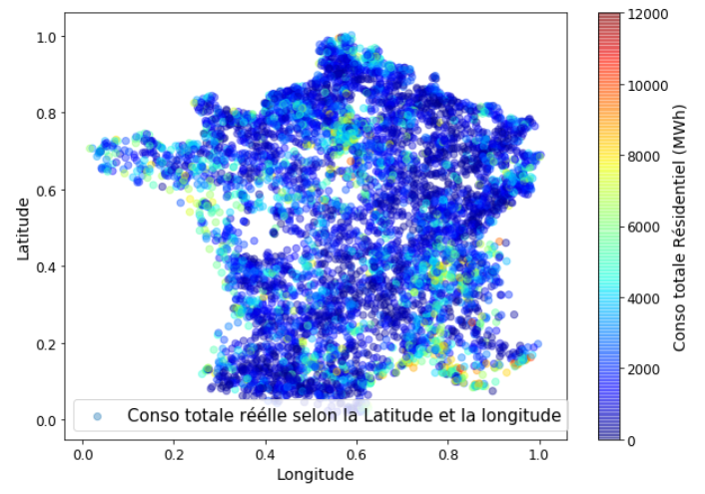
Machine Learning and Prediction

Slide 9
Discussion
RandomForestRegressor is slightly better than SVR
95% accuracy and 10% MAPE
Reduce overfitting:
Optimize parameters with GridSearchCV or RandomizedSearch
Get more external data
Try other algorithm :
Neural Network
Ensemble learning

Slide 10


Merci de votre attention
Notes:
27min

